Slide 1
Accounting Software
CodeZone

Slide 2
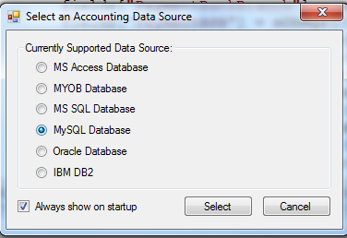
Login 1: Choose a datasource

Slide 3
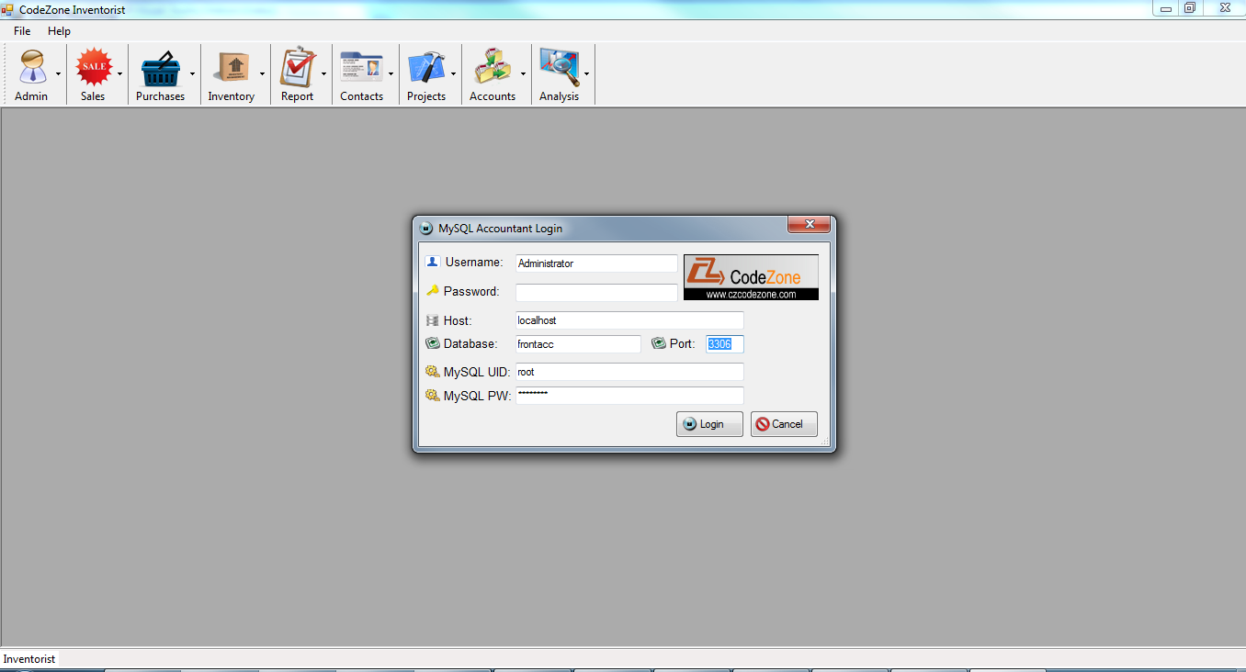
Login2: Account Validation

Slide 4
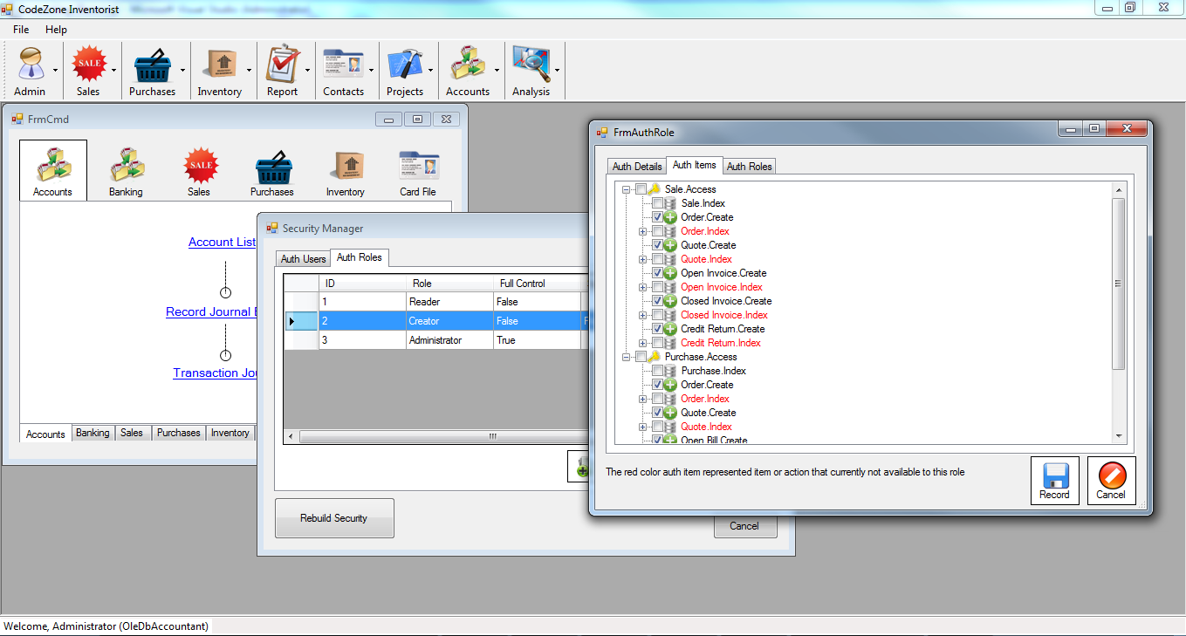
Security 1: Authorization role

Slide 5
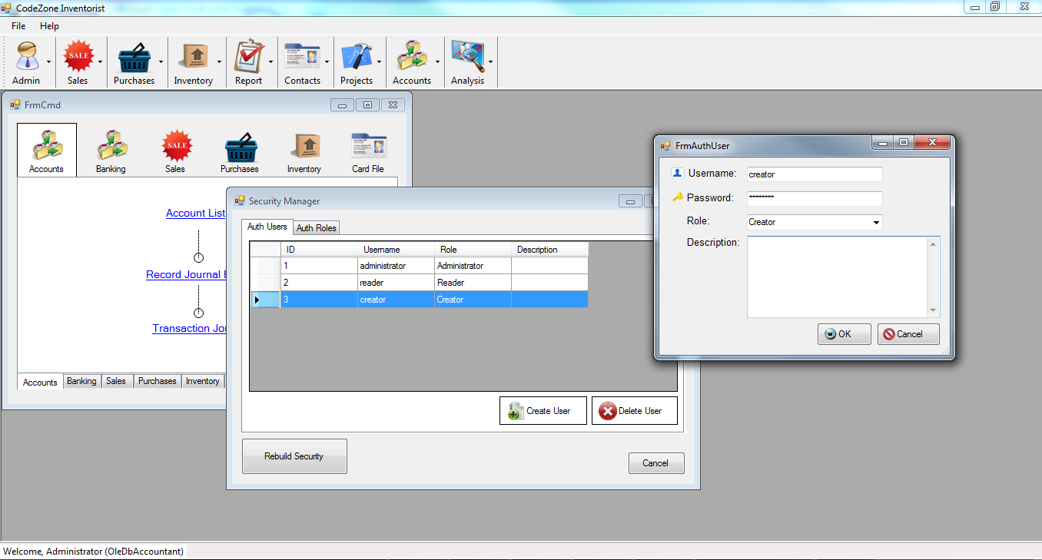
Security 2: User Account

Slide 6
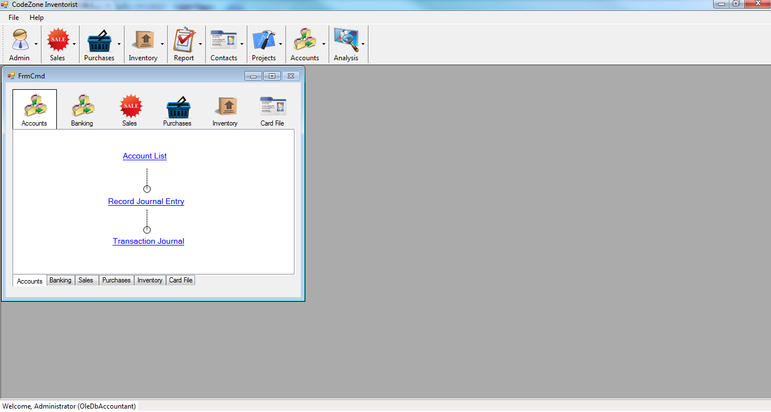
Home 1: On Login

Slide 7
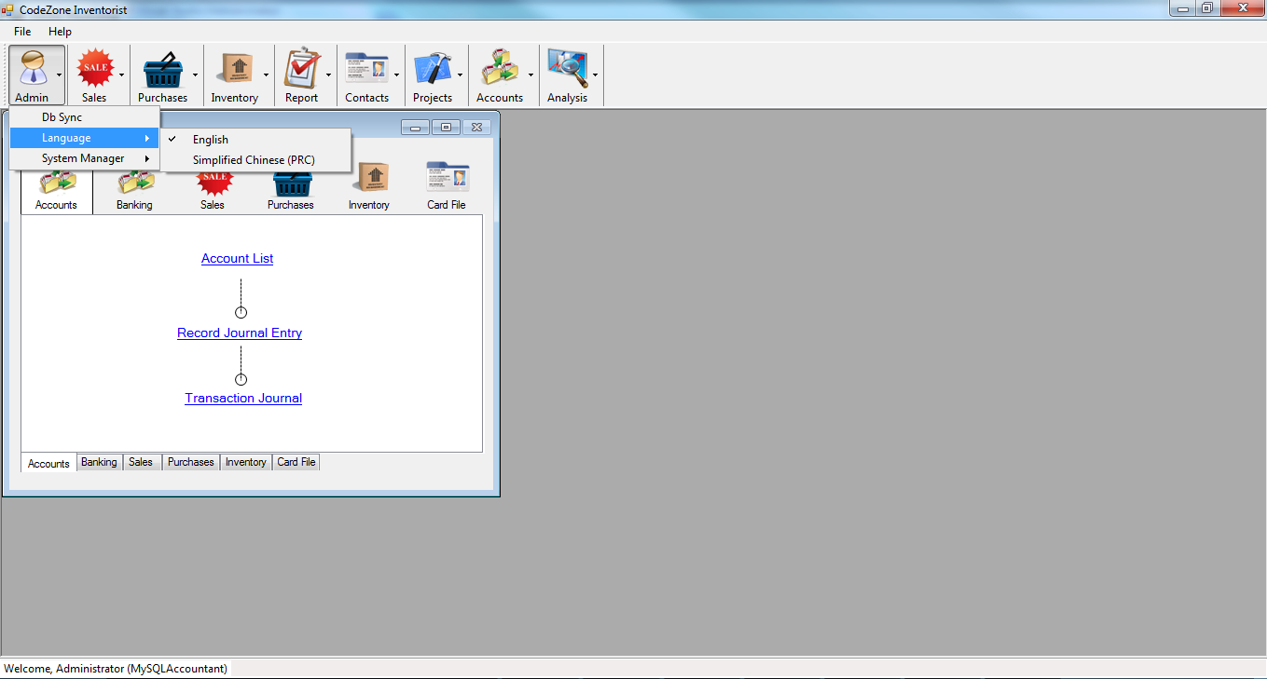
Home2: menu

Slide 8
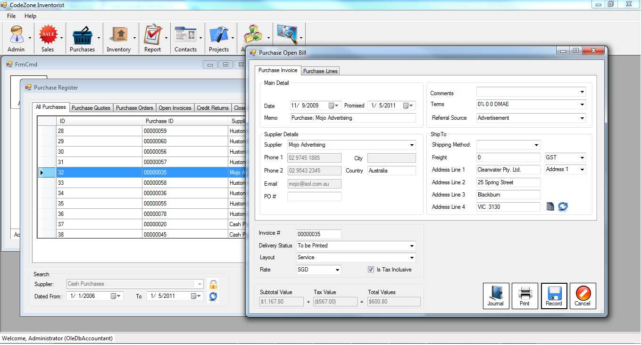
Purchase 1: Quote

Slide 9
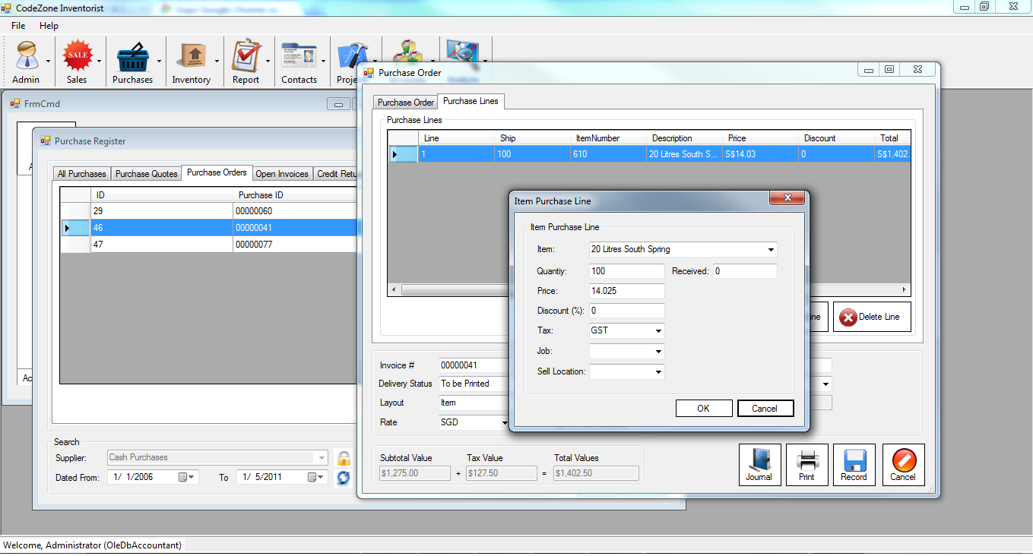
Purchase 2: Purchase Lines

Slide 10
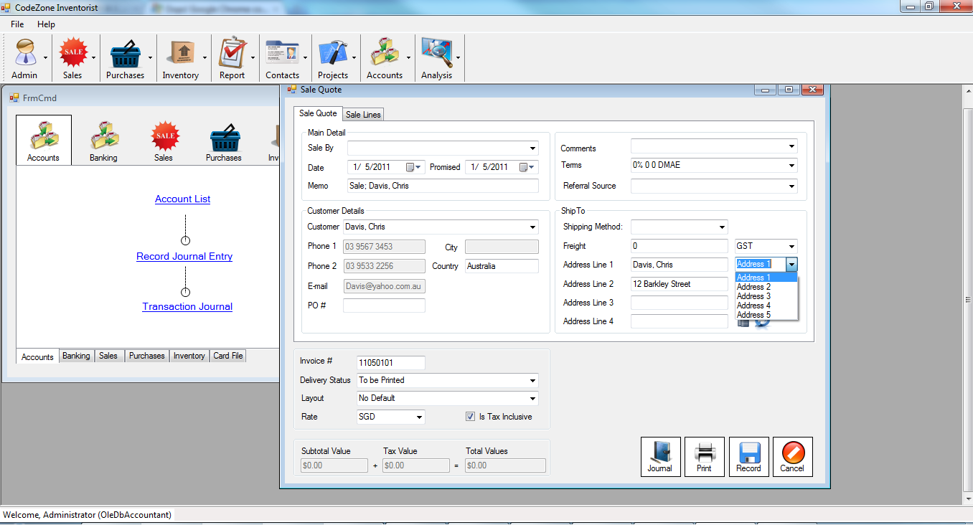
Sale 1: Customer Information

Slide 11
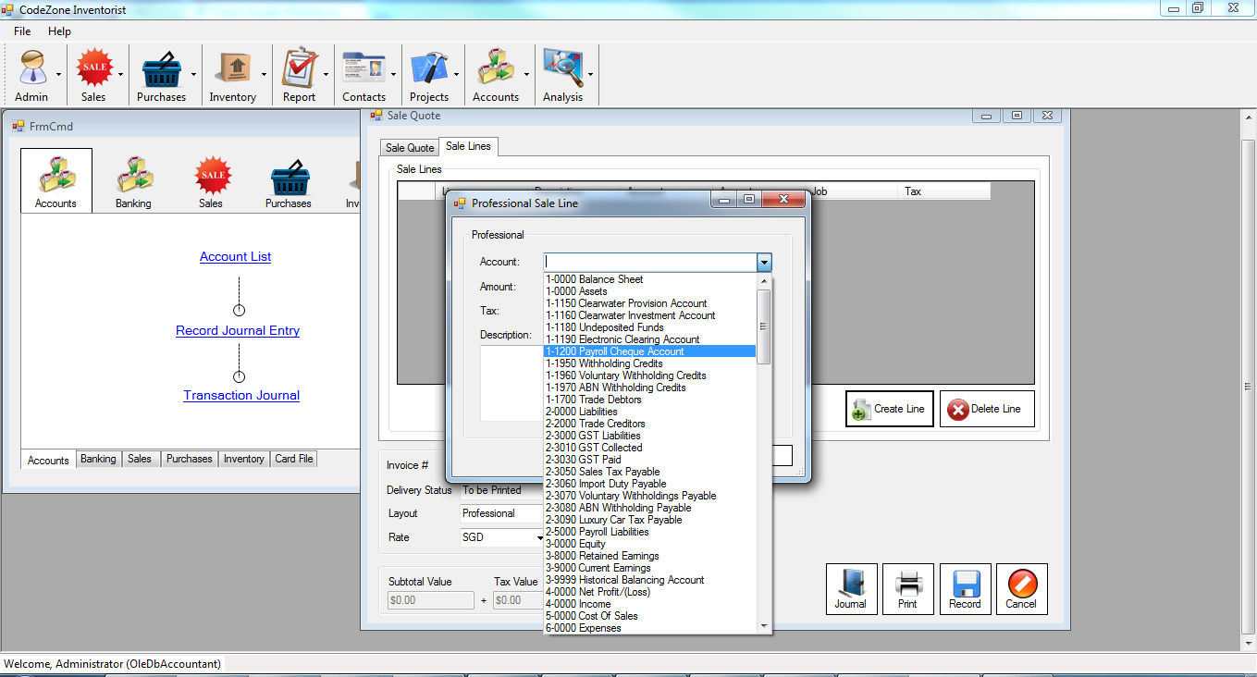
Sale 2: Professional sale Line

Slide 12
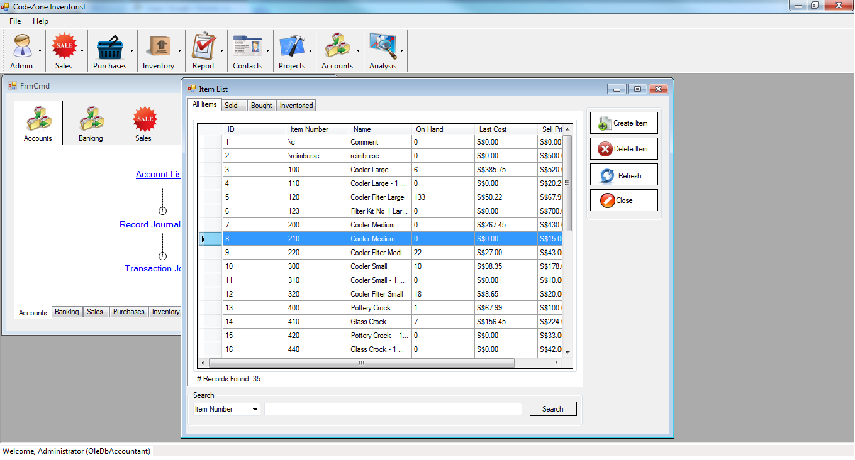
Inventory 1: items List

Slide 13
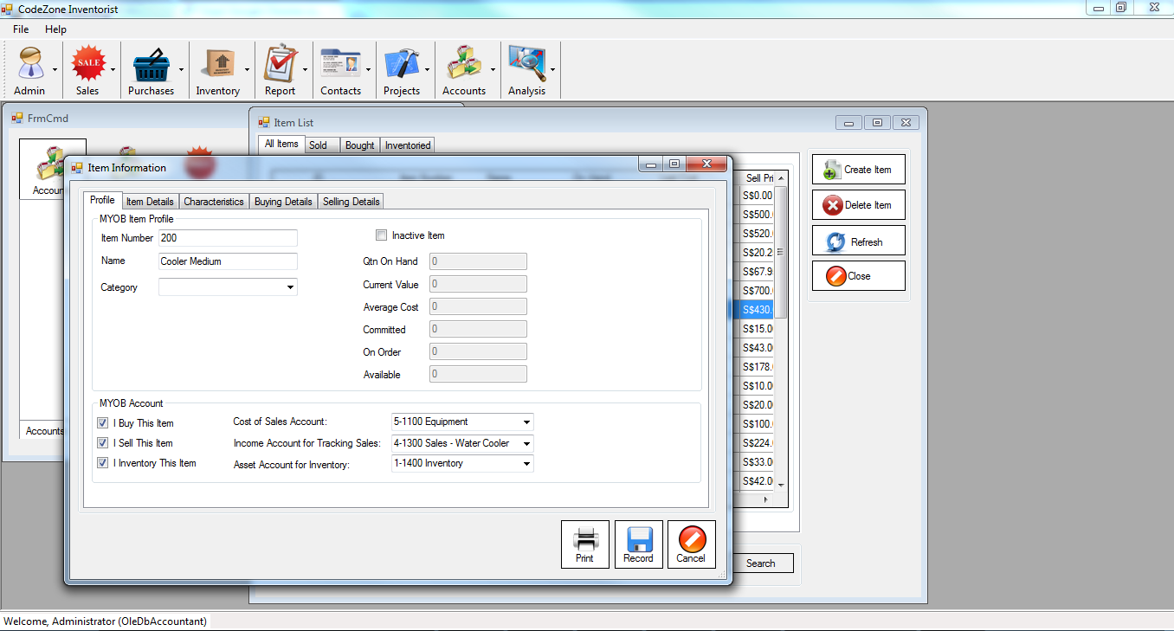
Inventory 2: item information

Slide 14
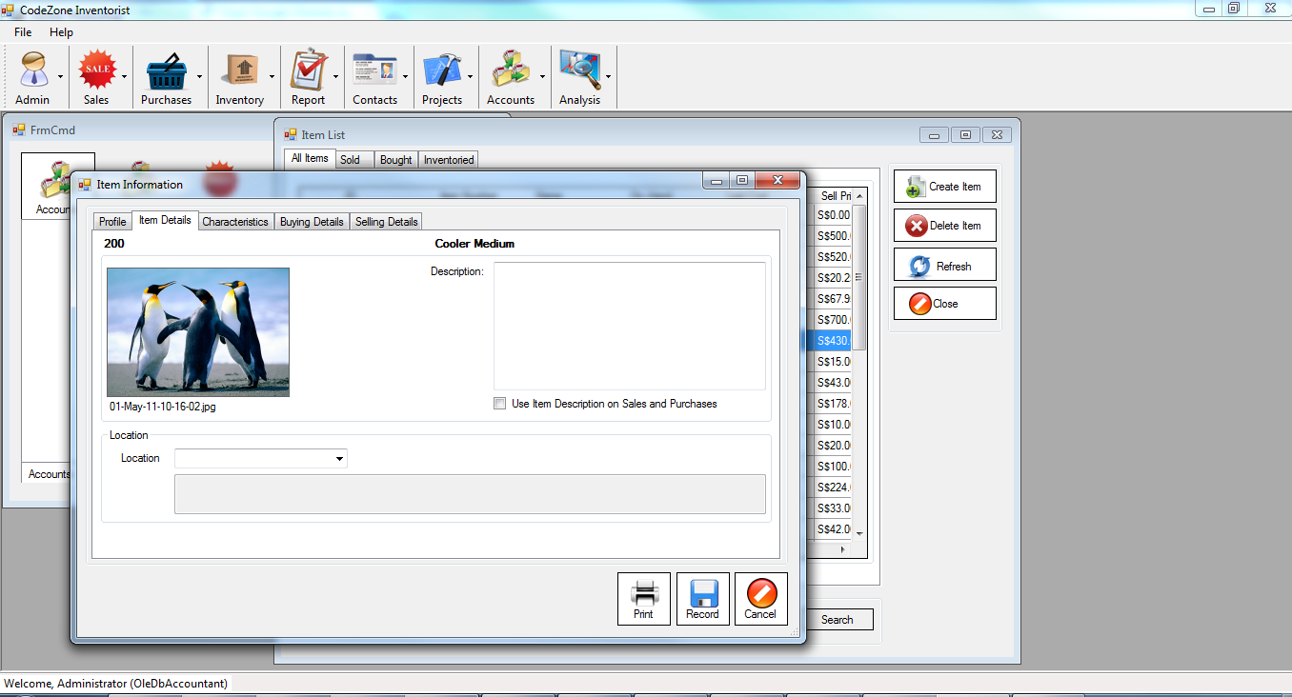
Inventory 3: item details

Slide 15
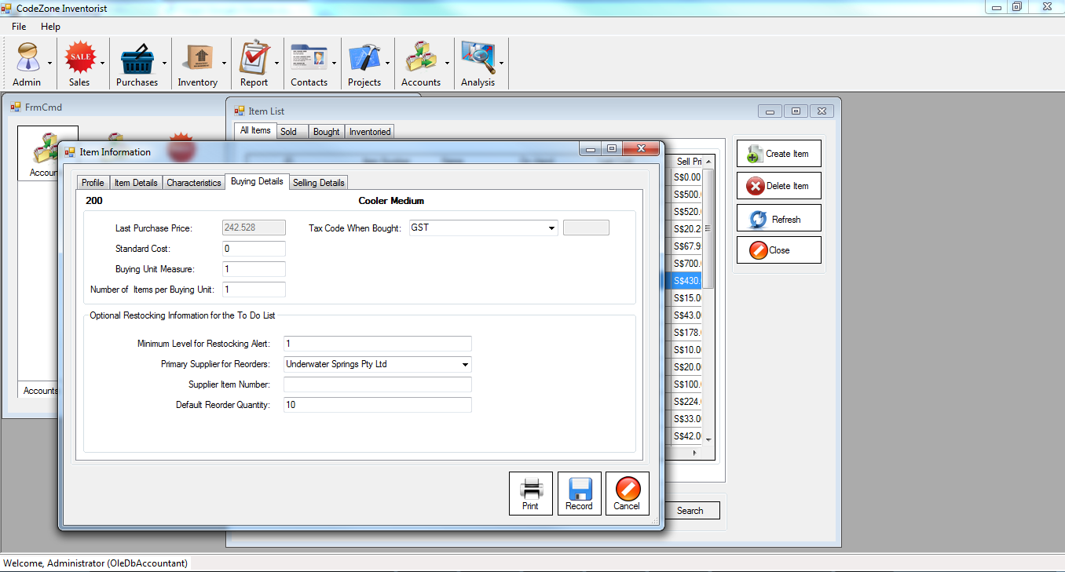
Inventory 4: Buying Details

Slide 16
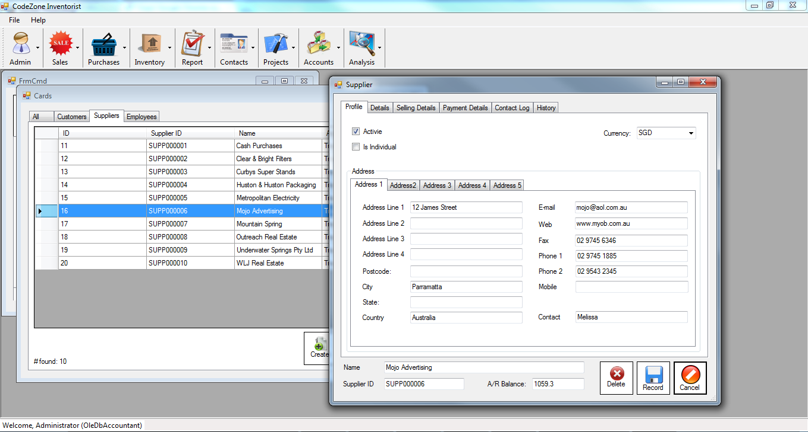
Card 1: Supplier information

Slide 17
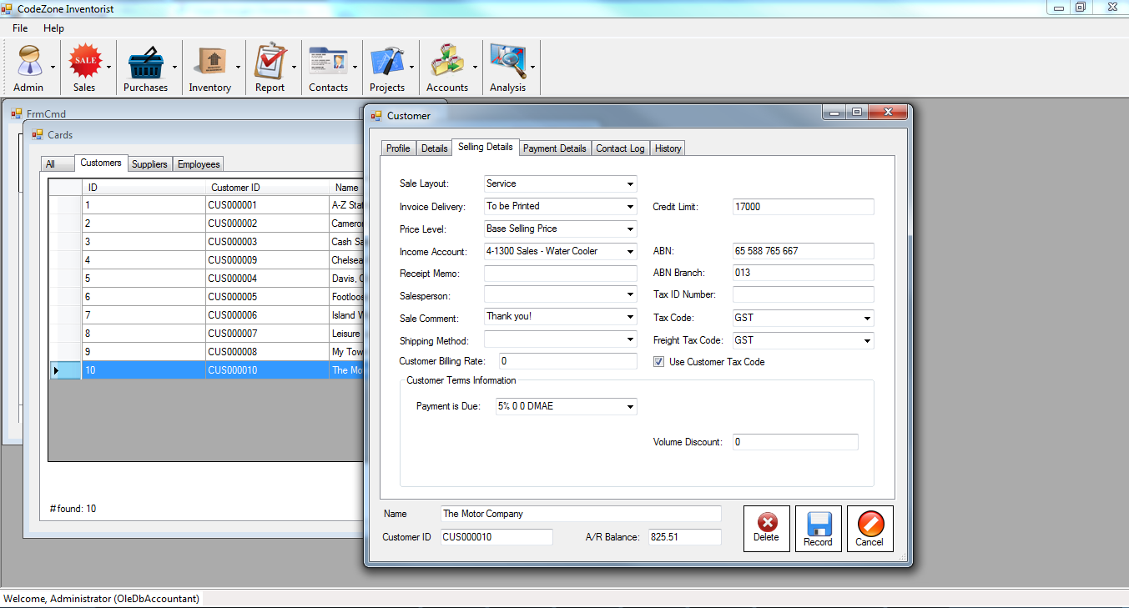
Card 2: Customer Information

Slide 18
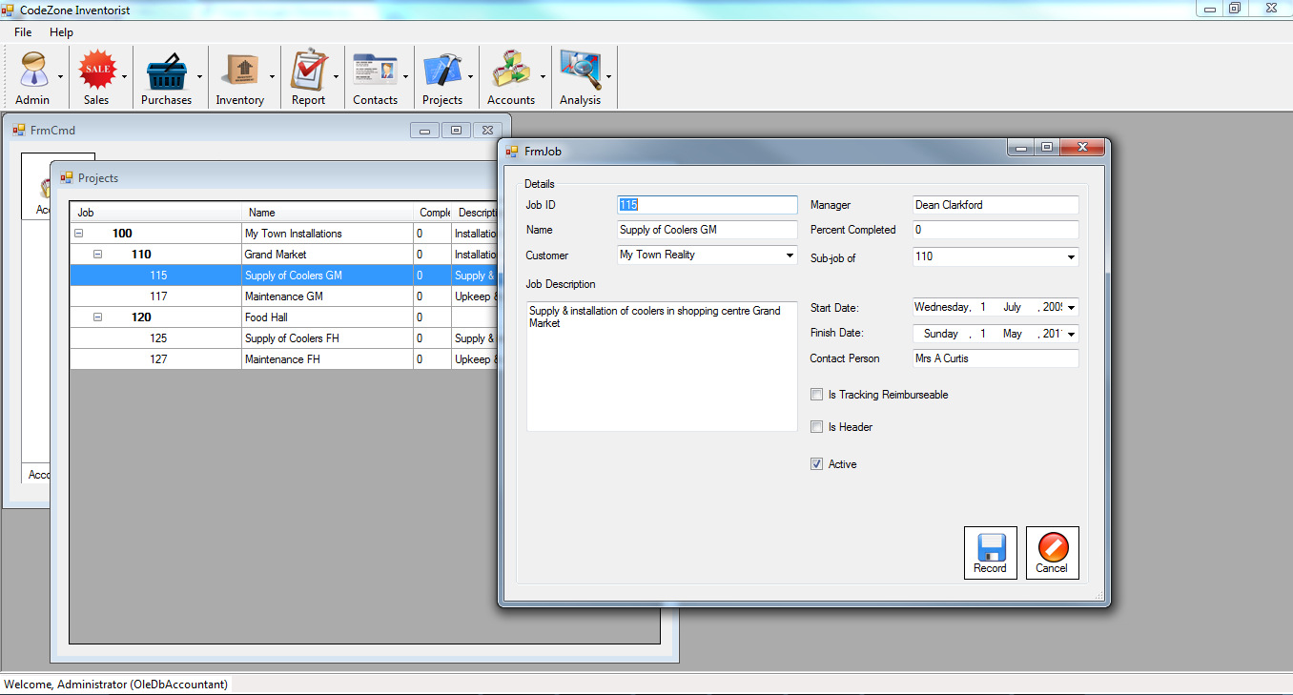
Project

Slide 19
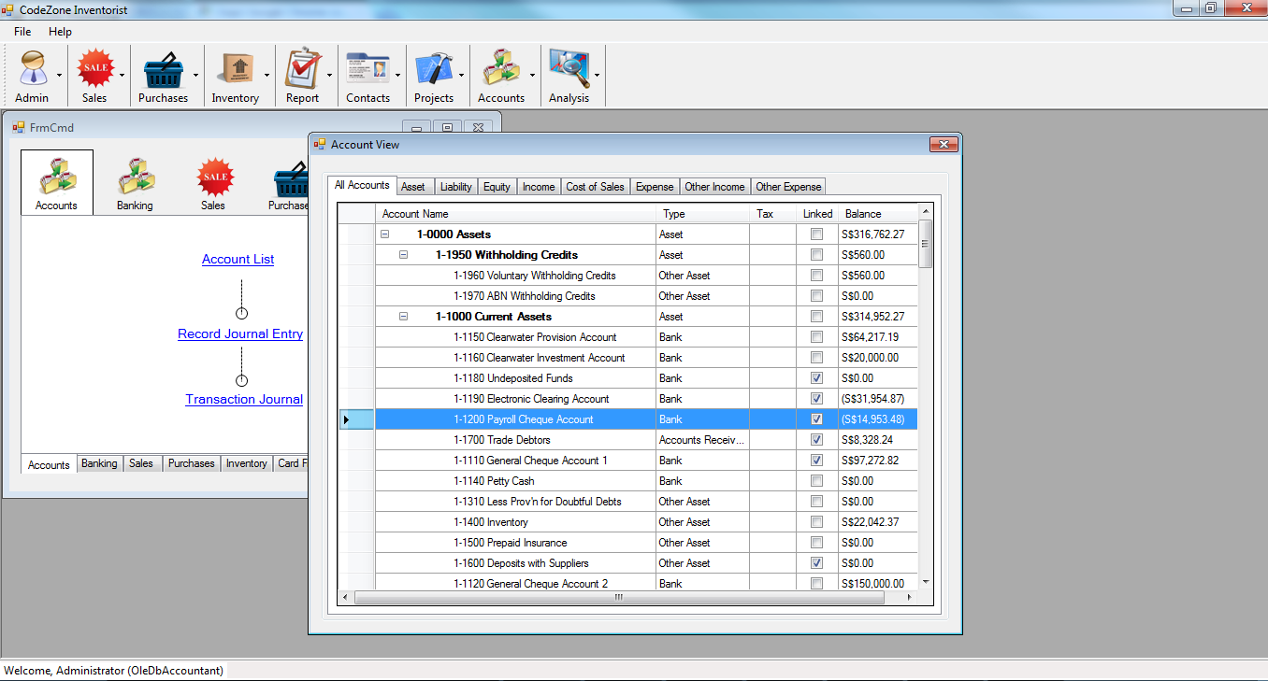
Account chart 1: Accounting Listing

Slide 20
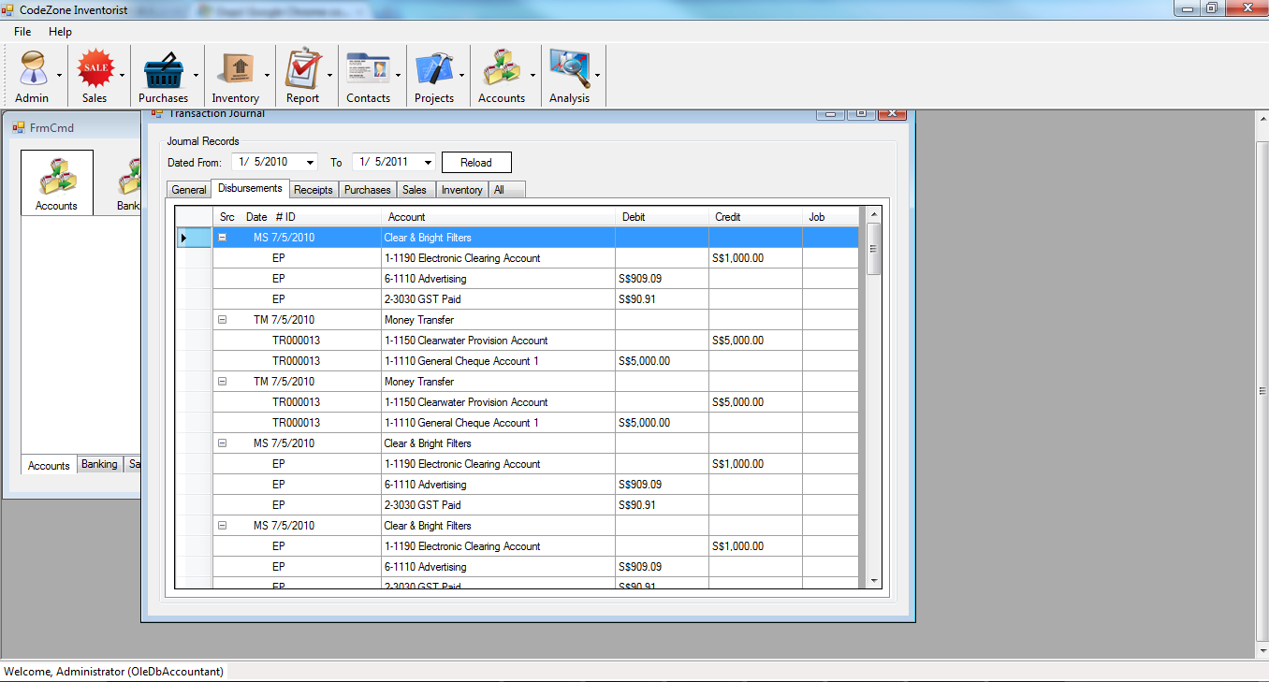
Transaction 1: Transaction Journals

Slide 21
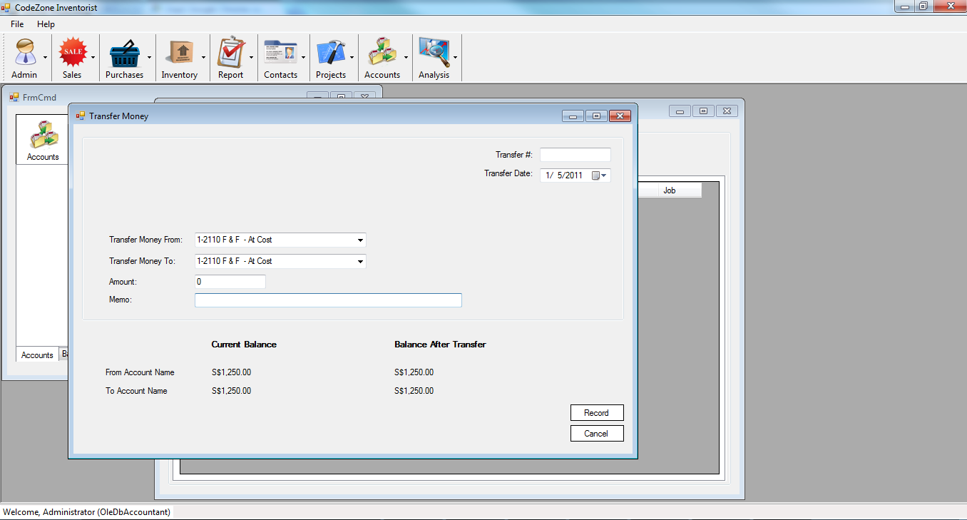
Transaction 2: Transfer Money

Slide 22
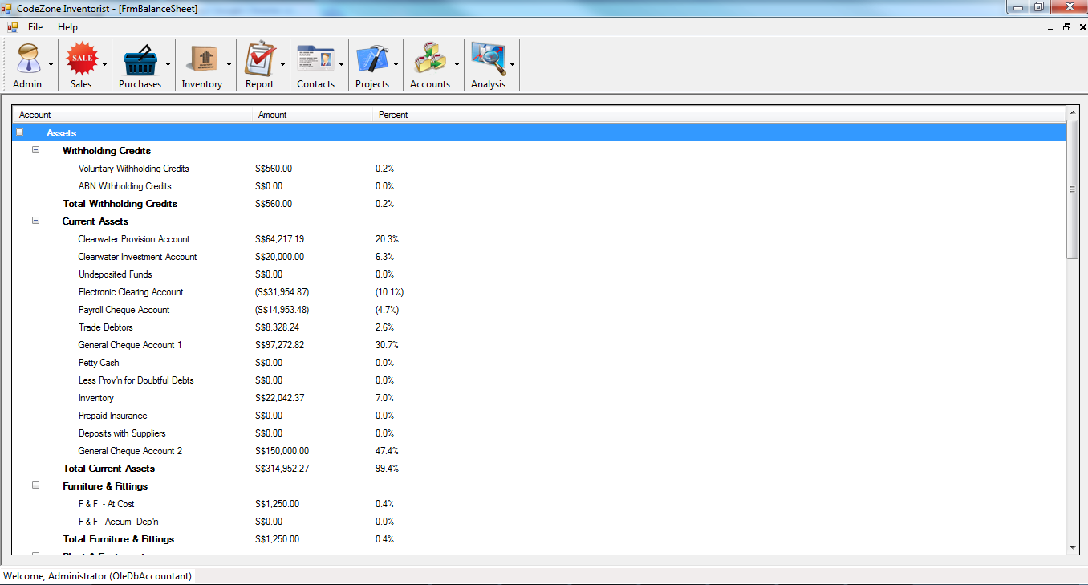
Analysis 1: Balance Sheet

Slide 23
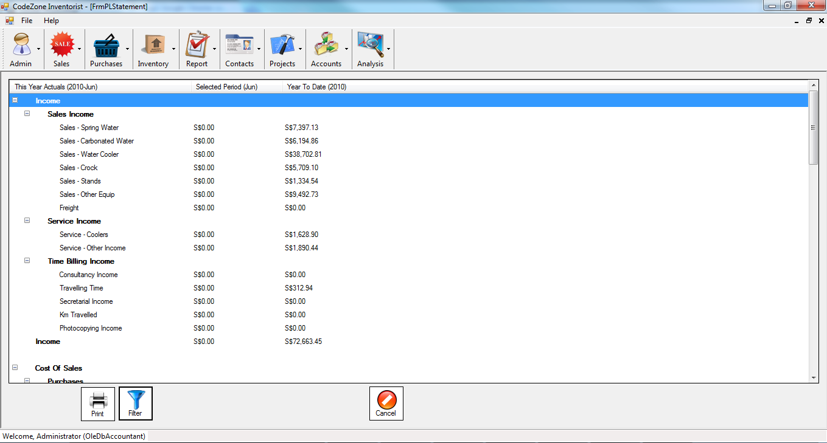
Analysis 2: Profit and Loss

Slide 24
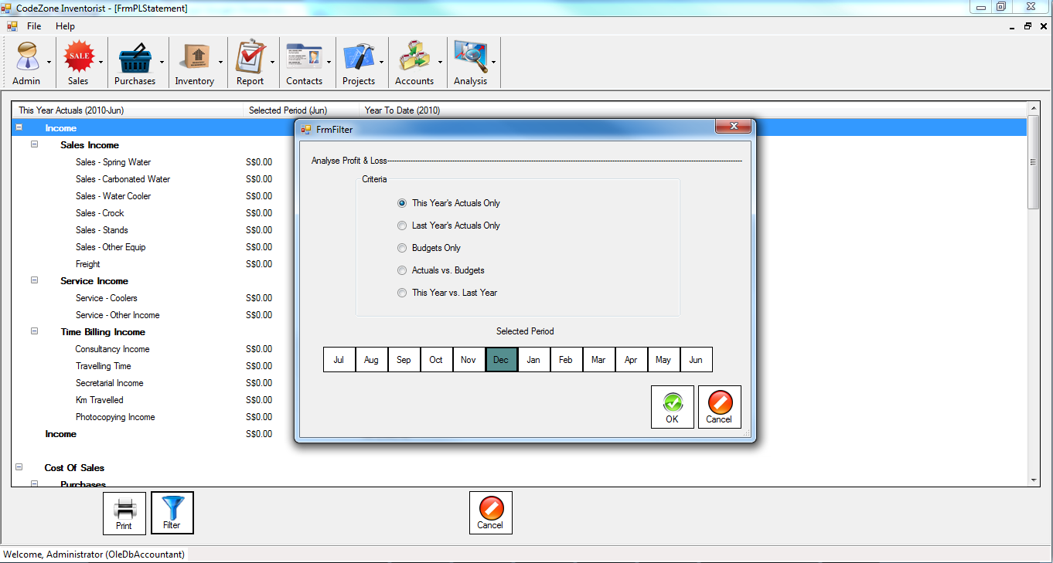
Analysis 3: Filter

Slide 25
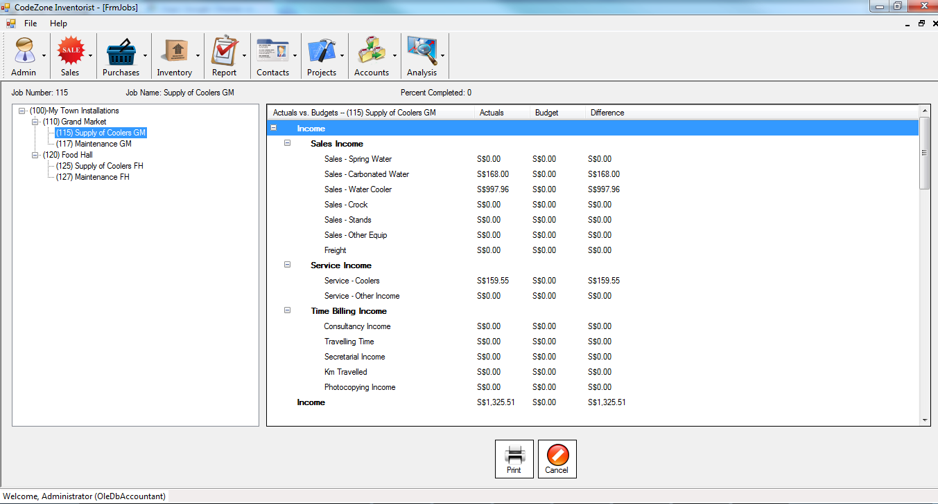
Analysis 4: Jobs and Project

Slide 26
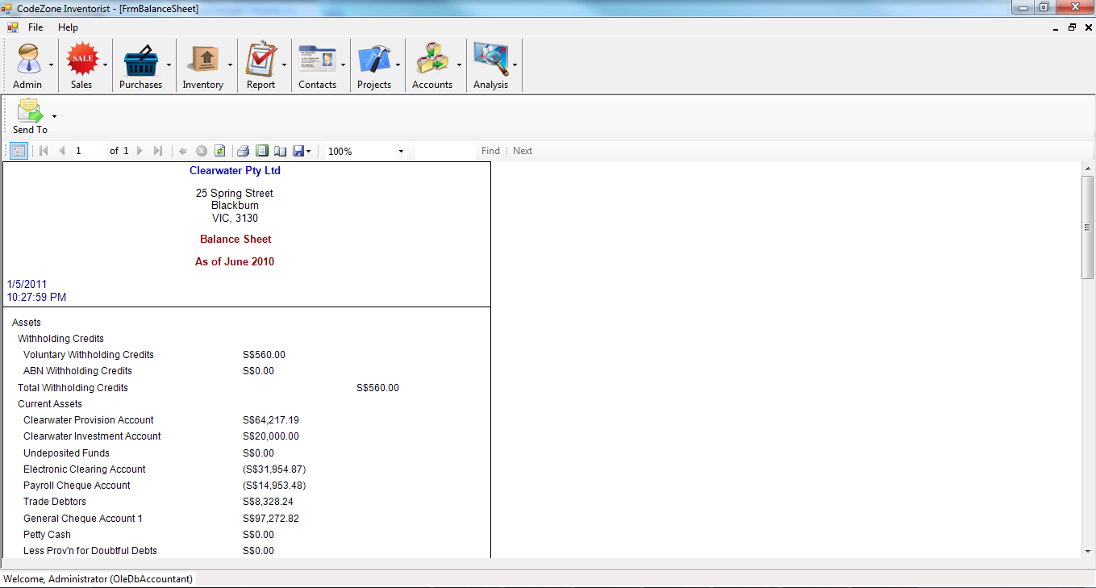
Report 1: Balance Sheet

Slide 27
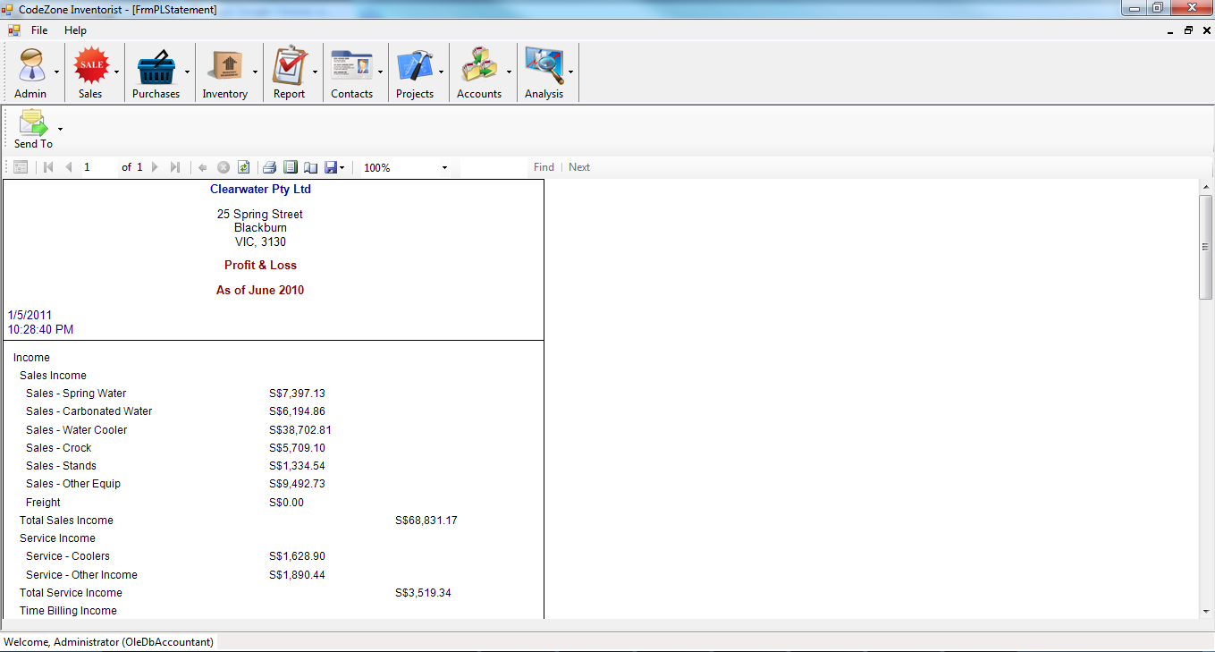
Report 2: Profit & Loss

Slide 28
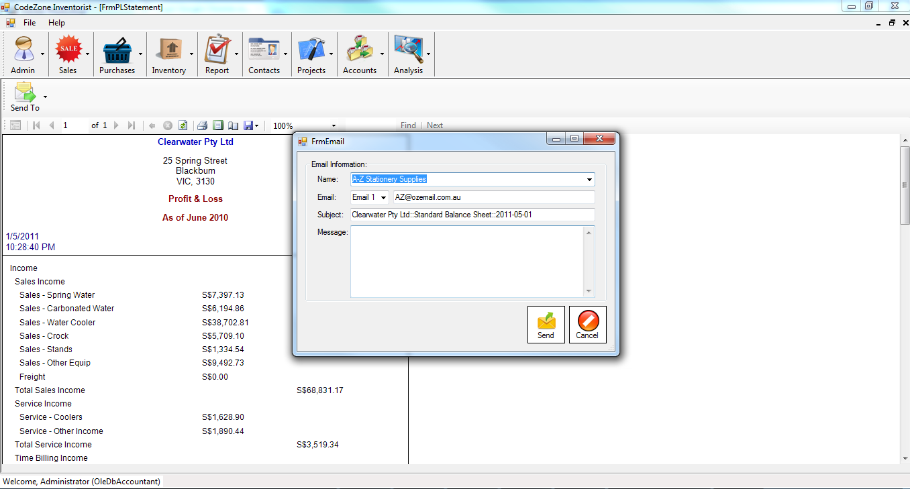
Report 3: Email

Slide 29
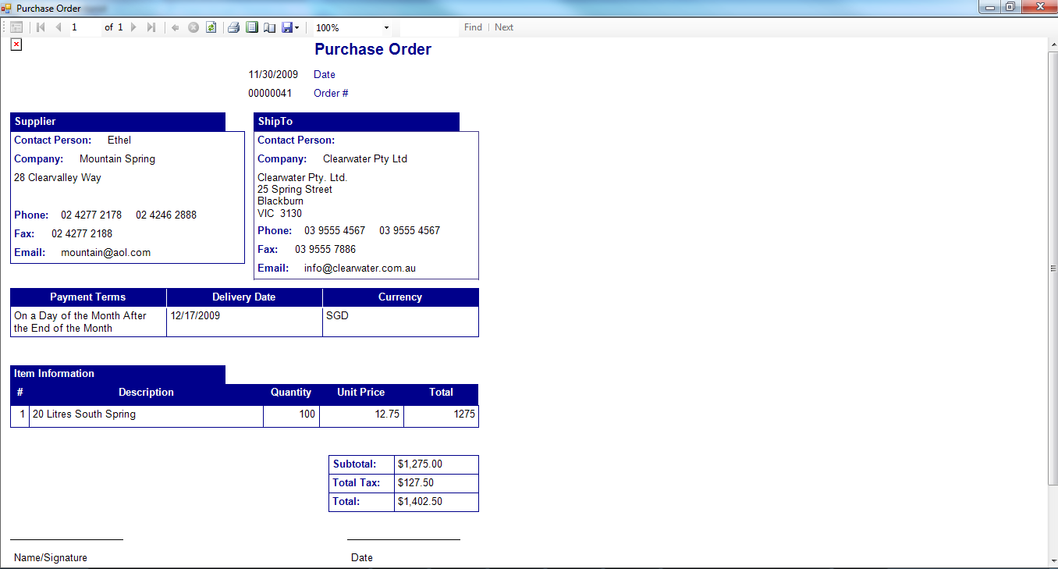
Invoice and Purchase Order…

